Slide 1
An update on WHO process, interim guidance and future guidelines. What’s next?
Mexico City, Mexico, July 21st 2019
James Kiarie and Petrus Steyn
Human Reproduction Team
Department of Reproductive Health and Research
Notes:
Good morning everyone and its my pleasure to make this presentation on behalf of WHO and the department of Reproductive health and Research. I would like to acknowledge my colleague Dr Igor Toskin with who we developed this presentation

Slide 2
What Has ECHO Told Us
No statistically significant differences in HIV infection rates (Observed differences less than 30%)
All methods were well accepted with high levels of safety and effectiveness in preventing pregnancy
The incidence of HIV infections was high
Prevalence of STIs was high at baseline and unchanged at study exit
Notes:
The 18th World Health Assembly in 1965 first recognized this right to address human reproductive health needs, from both fertility control and infertility treatment perspectives. Their message is true today as it was then “It is the choice of each individual, within their own sense of conscience, to determine the size of their family unit and the timing of when to have children”

Slide 3
Key Considerations In WHO Response to ECHO Trial
Access to preferred contraceptive methods should be maximized, while protecting women’s health
Women have the right to the latest and best information and to access a broad range of effective and acceptable methods
Current levels of contraceptive unmet need in many developing countries are not acceptable
Need to step up HIV and STI prevention efforts, particularly in high-burden countries and for young women

Slide 4
How Will WHO Addresses New evidence presented by ECHO
Evidence Synthesis
Values and Preferences
Guideline development
Guideline development Group advertised
Technical support
Communicating results and immediate policy responses
Additional studies after 2016 review
What does ECHO study add to the current evidence
GDG meeting 29-31 July 2019
Recommendations anticipated end of August 2019
Strengthening HIV/SRH integration
Continuing access to method options and choice

Slide 5
Evidence Synthesis
Updating of systematic review of observational evidence
Use of hormonal contraception among women at high risk of HIV (published evidence since January 2016)
Use of copper-bearing IUDs among women at high risk of HIV
Systematic review on contraceptive values and preferences
Engagement with women at high risk of HIV on their values and preferences concerning their risk of pregnancy and HIV acquisition
Qualitative study in Zimbabwe through CeSHHAR Sisters project
Qualitative study: online survey and in-depth interviews

Slide 6
Guidelines Development
GDG Announced 27 May
Women
Community
Implementers
Africa
GRADE including ECHO Quality of evidence
Benefits & harms
Values & preferences
Priority of the problem
Equity & human rights
Feasibility
Post GDG Process
Draft revised guidance
GDG and external review
Consolidation & final preparation
Submission for GRC approval
Editing and layout
Release and Dissemination
GDG meeting 29-31 July Contraceptive eligibility for women at High risk of HIV infection: All hormonal methods and intra-uterine devices
Notes:
The Rutstein and Shah definition is (much higher if clinical definition used). The Mascarenhas study was part of the 2010 Global Burden of Disease:
In terms of STI’s, The epidemiology of Chlamydia trachomatis (CT) in the Middle East and North Africa region (MENA) is poorly understood.
Concurrently, MENA is estimated to have the highest rates of primary infertility worldwide → possibility of substantial “hidden” chlamydia infection levels?
WHO is involved In an initiative to synthesize all epidemiological data on chlamydia prevalence and incidence in MENA
This will estimate chlamydia prevalence among different population groups and identify associations with higher chlamydia prevalence in MENA.

Slide 7
Technical Support
Convened 14 High HIV prevalence countries in Lusaka 10-11 July 2019
Presentation of ECHO primary and secondary analysis
Expansion of method mix and promotion of choice
Strengthening HIV prevention in family planning services
Supporting country task teams
Immediate responses
Long term plans

Slide 8
Highlights from Lusaka meeting
136 participants with 16 of 18 priority countries represented
Immediate actions next 1 month
Varied prioritized country actions before the revised WHO guidance is available
Approach of multiple funders from different parts of the world for globally-important studies like ECHO with potentially sensitive results.
Funders to consider the policy implications of the ECHO study in planning funding
Longer term
Large implementation science project that dually advancing family planning and HIV prevention
Service delivery that places women needs at the center by addressing the full range of their needs including contraceptive options, HIV and STI prevention
Strengthen country task teams to work on expanding method mix and better integration of HIV/STI prevention and contraception services
Notes:
Varied prioritized action before the revised WHO guidance is available: entrenching, expanding or convening task teams, communicating the results and their implications, SWOT and gap analysis and discussing possible further research
Having multiple funders from different parts of the world was highlighted as critical for such globally-important studies like ECHO with potentially sensitive results.
Some donors (PEPFAR and Global Fund) indicated that they would be considering the policy implications of the ECHO study in future funding planning
Address the full range of those needs including a full complement of contraceptive options, HIV and STI prevention.
Entrench the task teams to work on expanding method mix and better integration of HIV, STI and contraception services.

Slide 9
Global Leadership
Resources available to support response to the ECHO trial results
WHO statement in response to the ECHO study results
Responses to frequently asked questions
Current WHO recommendations
Key messages for policy makers, providers and women for high and low HIV prevalence countries
The World Health Organization (WHO) Director-General has established the WHO Advisory Group of Women Living with HIV
Ensure their perspectives represented in WHO’s work
Recommend priorities
Review and monitor WHO progress
Provide feedback on WHO normative guidance
Advise on values and preferences work
Photo: Garry Knight
https://www.who.int/reproductivehealth/hc-hiv/en/

Slide 10
Where Are We Now
Media has been very positive and balanced: Increase focus on method mix and options and HIV prevention
Call for HIV/SRH integration and for method mix and options may work: Commitment, Task teams in countries and FP can leverage the HIV advocacy machine
Expectations re guidelines: Be definitive, Follow through to ensure implementation and Engage communities

Slide 11
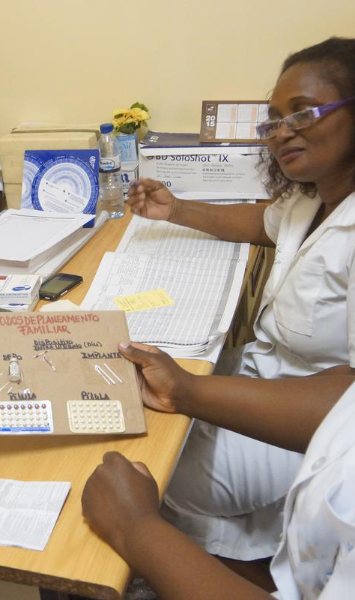
IAS 2019
Mexico City, Mexico
23 July 2019
07:00 – 08:30
Venue: Casa del Diezmo 1 y 2
WHO response to the results of the Evidence for Contraceptive Options and HIV Outcomes (ECHO) study
Access to sexual and reproductive health services and information, including a full range of contraceptive methods, is a fundamental human right critical to the well-being of women and girls. Mixed evidence as to whether the use of hormonal contraceptive methods (HC) are associated with increased risk of women acquiring HIV with interpretation of data challenging, as women using HC may have other behavioural characteristics that could affect their risk of HIV. The ECHO Study is an open-label randomised clinical trial to evaluate whether there are differences in the risk of acquiring HIV infection among users of three highly effective, reversible contraceptive methods. Translating research into policy must account for the needs and concerns of multiple stakeholders including the people it ultimately will affect. This session highlights several aspects of the WHO response showing the process, challenges and considerations. It is aimed at policy makers, ministries of health, advocates and researchers.
Chair (World Health Organization, Department of Reproductive Health and Research)
James Kiarie, Coordinator, Human Reproduction Team
Speakers
Helen Rees, Wits Reproductive Health and HIV Institute (WRHI), South Africa
Welcome and introduction
Jared Baeten, Departments of Global Health and Epidemiology, International Clinical Research Center, University of Washington, United States
Summary main results
Petrus Steyn, WHO Human Reproduction Team, Geneva
Rethinking Reproductive health including contraception programmes in the context of the results
Rachel Baggaley, WHO CDS/HIV, Geneva
Rethinking HIV programmes in the context of the results (Rachel Baggaley, WHO, HQ, Geneva)
Yvette Raphael, International Community of women living with HIV Eastern Africa (ICWEA), Uganda
What should the advocacy agenda for HIV and reproductive health linkages be?
Nelly Mugo, KEMRI, Kenya
Immediate country responses and plans
Photo: Arturo Sanabria, Photoshare
For further details:
Dr Petrus Steyn: steynp@who.int

Slide 12
Department of Reproductive Health and Research (RHR) including the UNDP/UNFPA/UNICEF/WHO/World Bank Special programme of research, development and research training in human reproduction (HRP)
Follow us on Twitter @HRPresearch
Visit our website who.int/reproductivehealth/hc_hiv

